Slide 1
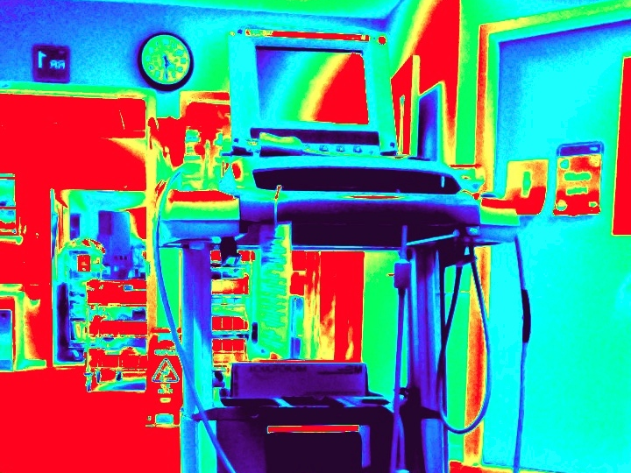
edus² workout
Paul Olszynski, MD, MEd, CCFP (EM)
CAEP14

Slide 2
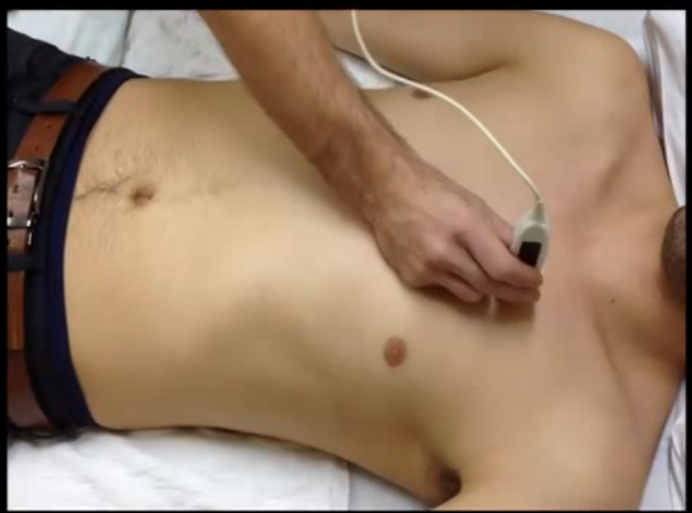
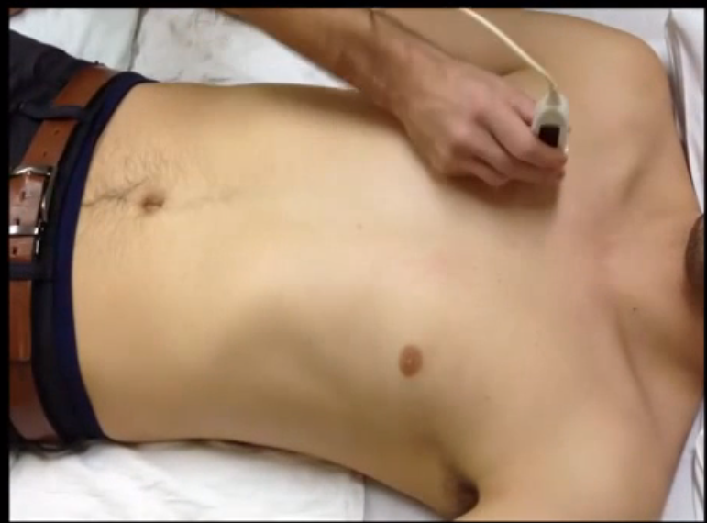
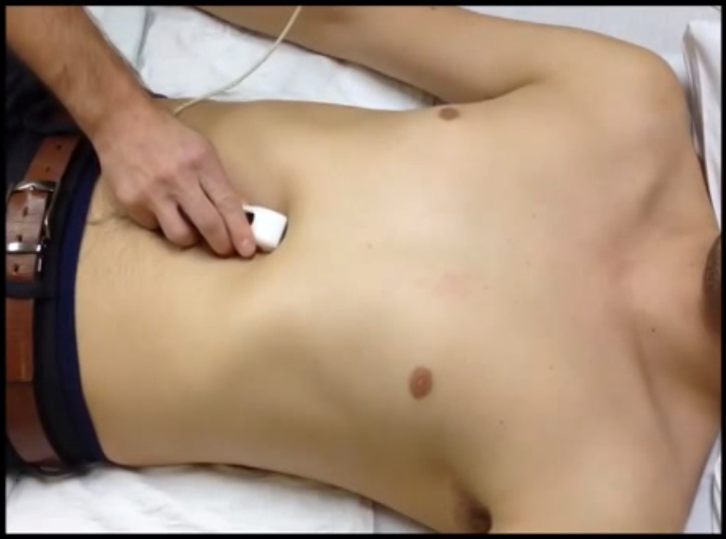
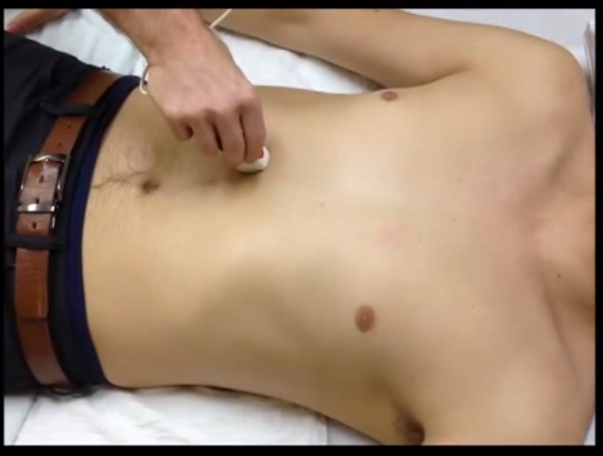
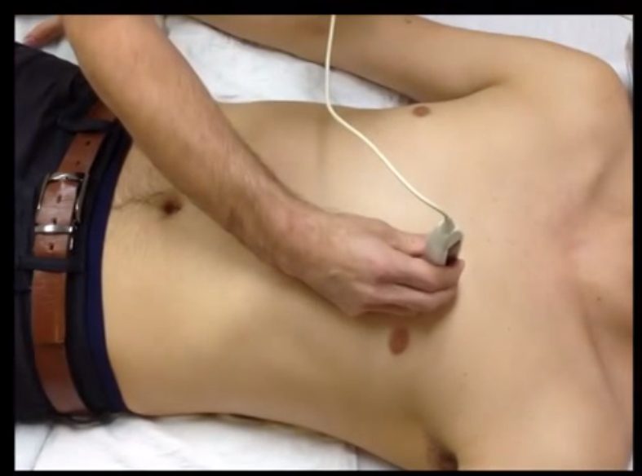
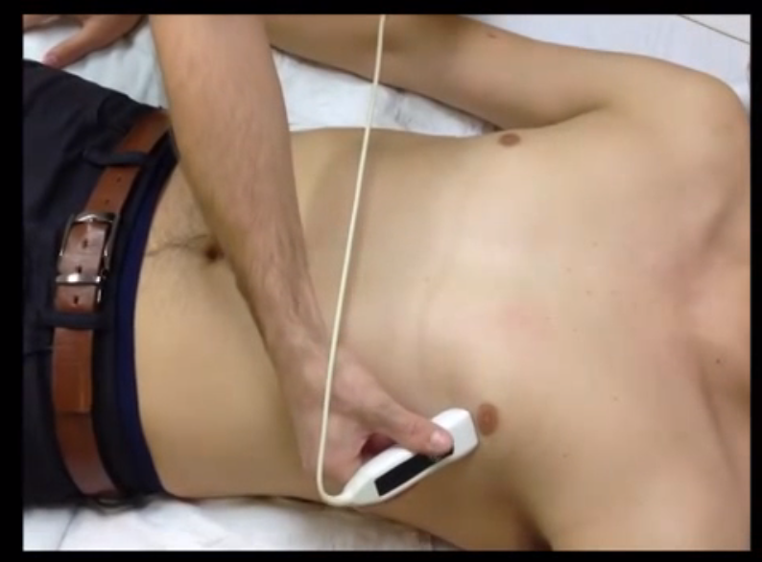

Slide 3
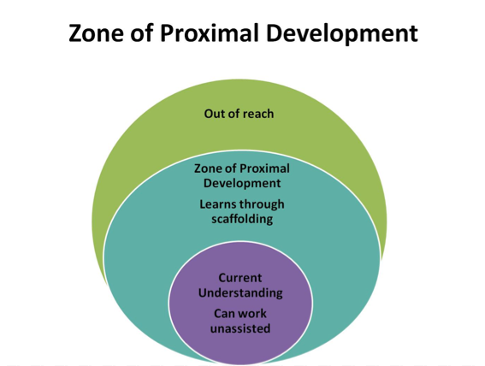
http://wordplay11.wordpress.com/2014/04/16/incorporating-theory-into-practice/
Notes:
http://wordplay11.wordpress.com/2014/04/16/incorporating-theory-into-practice/

Slide 4
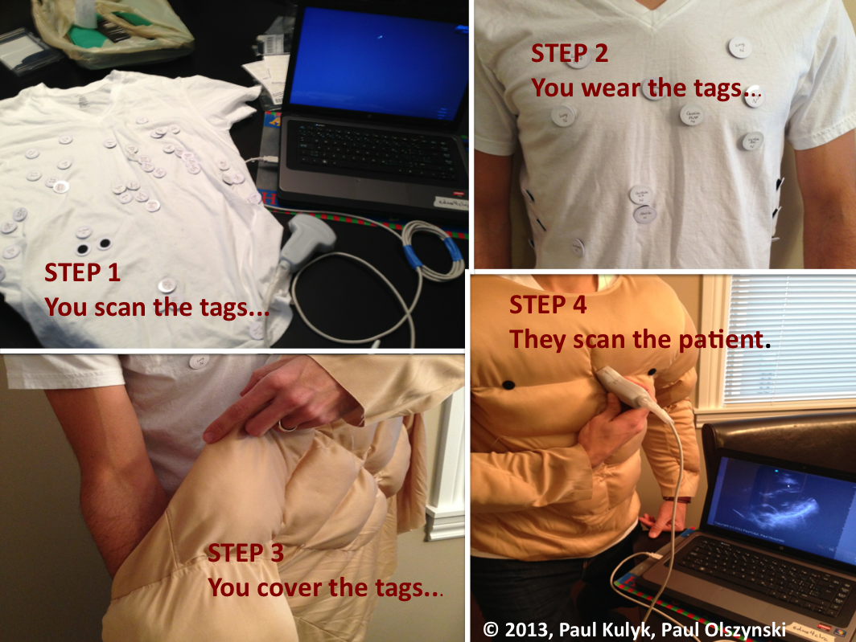

Slide 5
‘edus² workout’ hypothesis
Better critical care sonologists through:
  improved awareness of indications for EDUS
  memorization of scan protocols & choreography
    EGLS, RUSH, EFAST
  rehearsed integration of findings into clinical contexts
  review of landmarks and probe positioning
    no value for learning probe driving/image generation

Slide 6
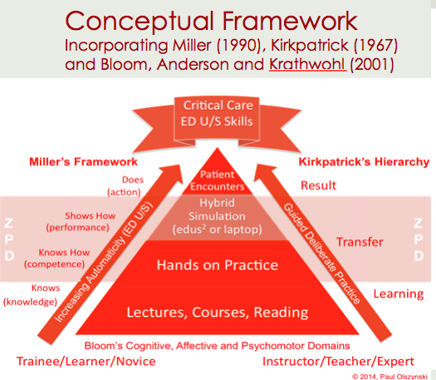

Slide 7
Conclusion
‘edus2 workout’ may contribute to development of critical care ED U/S skills
  NB: match task/skill to simulator function
Goal: Improved Clinician Performed Ultrasound in critical care through:
  knowledge and deliberate practice of
    indications
    protocols
    landmarks
    clinical integration

Slide 8
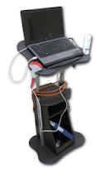
Questions?
www.edus2.com

Slide 9
References
Ericsson, K. A., Krampe, R. Th., & Tesch-Romer, C. (1993). The role of deliberate practice in the acuisition of expert performance. Psychological Review, 100(3), 363-406.
Hamstra, S. J., Brydges, R., Hatala, R., Zendejas, B., Cook, A. (2014). Reconsidering fidelity in simulation-based training. Academic Medicine, 89 (3), 387-392.
Kirkpatrick, D. (1996). Revisiting Kirkpatrick's four-level model. Training and Development, 50, 54-59.
Lanctot, Y. F., Valois, M., & Bealieu, B. (2011). EGLS: Echo-guided life support. an algorithmic approach to undifferentiated shock. Critical Ultrasound Journal, 3, 123-129.
Miller, G. E. (1990). The assessment of clinical skills/competence/performance. Acad.Med., 65(9 Suppl), S63-S67.
Sanders, D., & Welk, D. S. (2005). Strategies to scaffold student learning: applying Vygotsky's Zone of Proximal Development. Nurse Educ., 30(5), 203-207.

